Slide 1
Computer Systems:
A Programmer’s Perspective
程序设计与计算机系统
Lecture 6b
Cache Memory
October 21, 2011
Wu junmin (jmwu@ustc.edu.cn)

Slide 2
Today
Cache memory organization and operation
Performance impact of caches
  The memory mountain
  Rearranging loops to improve spatial locality
  Using blocking to improve temporal locality

Slide 3
Cache Memories
Cache memories are small, fast SRAM-based memories managed automatically in hardware.
  Hold frequently accessed blocks of main memory
CPU looks first for data in caches (e.g., L1, L2, and L3), then in main memory.
Typical system structure:
CPU chip
Register file
ALU
Cache
memories
System bus
Memory bus
Main
memory
Bus interface
I/O
bridge

Slide 4
General Cache Organization (S, E, B)
E = 2e lines per set
set
line
S = 2^{s} sets
Cache size:
C = S x E x B data bytes
v
tag
0
1
2
B-1
valid bit
B = 2^{b} bytes per cache block (the data)

Slide 5
Cache Read
Locate set
Check if any line in set
has matching tag
Yes + line valid: hit
Locate data starting
at offset
E = 2e lines per set
Address of word:
t bits
s bits
b bits
S = 2^{s} sets
tag
set
index
block
offset
data begins at this offset
v
tag
0
1
2
B-1
valid bit
B = 2^{b} bytes per cache block (the data)

Slide 6
Example: Direct Mapped Cache (E = 1)
Direct mapped: One line per set
Assume: cache block size 8 bytes
Address of int:
v
tag
0
1
2
3
4
5
6
7
t bits
0…01
100
v
tag
0
1
2
3
4
5
6
7
find set
S = 2^{s} sets
v
tag
0
1
2
3
4
5
6
7
v
tag
0
1
2
3
4
5
6
7

Slide 7
Example: Direct Mapped Cache (E = 1)
Direct mapped: One line per set
Assume: cache block size 8 bytes
Address of int:
valid? +
match: assume yes = hit
t bits
0…01
100
v
tag
0
1
2
3
4
5
6
7
tag
block offset

Slide 8
Example: Direct Mapped Cache (E = 1)
Direct mapped: One line per set
Assume: cache block size 8 bytes
Address of int:
valid? +
match: assume yes = hit
t bits
0…01
100
v
tag
0
1
2
3
4
5
6
7
block offset
int (4 Bytes) is here
No match: old line is evicted and replaced

Slide 9




Direct-Mapped Cache Simulation
t=1
s=2
b=1
M=16 byte addresses, B=2 bytes/block,
S=4 sets, E=1 Blocks/set
Address trace (reads, one byte per read):
0 [0000₂],
1 [0001₂],
7 [0111₂],
8 [1000₂],
0 [0000₂]
x
xx
x
miss
hit
miss
miss
miss
v
Tag
Block
Set 0
Set 1
Set 2
Set 3

Slide 10
A Higher Level Example
Ignore the variables sum, i, j
assume: cold (empty) cache,
a[0][0] goes here
int sum_array_rows(double a[16][16])
{
int i, j;
double sum = 0;
for (i = 0; i < 16; i++)
for (j = 0; j < 16; j++)
sum += a[i][j];
return sum;
}
int sum_array_cols(double a[16][16])
{
int i, j;
double sum = 0;
for (j = 0; i < 16; i++)
for (i = 0; j < 16; j++)
sum += a[i][j];
return sum;
}
32 B = 4 doubles
blackboard

Slide 11
E-way Set Associative Cache (Here: E = 2)
E = 2: Two lines per set
Assume: cache block size 8 bytes
Address of short int:
t bits
0…01
100
v
tag
0
1
2
3
4
5
6
7
v
tag
0
1
2
3
4
5
6
7
v
tag
0
1
2
3
4
5
6
7
v
tag
0
1
2
3
4
5
6
7
find set
v
tag
0
1
2
3
4
5
6
7
v
tag
0
1
2
3
4
5
6
7
v
tag
0
1
2
3
4
5
6
7
v
tag
0
1
2
3
4
5
6
7

Slide 12
E-way Set Associative Cache (Here: E = 2)
E = 2: Two lines per set
Assume: cache block size 8 bytes
Address of short int:
compare both
t bits
0…01
100
valid? +
match: yes = hit
v
tag
0
1
2
3
4
5
6
7
tag
v
tag
0
1
2
3
4
5
6
7
block offset

Slide 13
E-way Set Associative Cache (Here: E = 2)
E = 2: Two lines per set
Assume: cache block size 8 bytes
Address of short int:
compare both
t bits
0…01
100
valid? +
match: yes = hit
v
tag
0
1
2
3
4
5
6
7
v
tag
0
1
2
3
4
5
6
7
block offset
short int (2 Bytes) is here
No match:
One line in set is selected for eviction and replacement
Replacement policies: random, least recently used (LRU), …

Slide 14




2-Way Set Associative Cache Simulation
t=2
s=1
b=1
xx
x
x
M=16 byte addresses, B=2 bytes/block,
S=2 sets, E=2 blocks/set
Address trace (reads, one byte per read):
0 [0000₂],
1 [0001₂],
7 [0111₂],
8 [1000₂],
0 [0000₂]
miss
hit
miss
miss
hit
v
Tag
Block
Set 0
0
Set 1
0
0

Slide 15
A Higher Level Example
Ignore the variables sum, i, j
assume: cold (empty) cache,
a[0][0] goes here
int sum_array_rows(double a[16][16])
{
int i, j;
double sum = 0;
for (i = 0; i < 16; i++)
for (j = 0; j < 16; j++)
sum += a[i][j];
return sum;
}
32 B = 4 doubles
int sum_array_rows(double a[16][16])
{
int i, j;
double sum = 0;
for (j = 0; i < 16; i++)
for (i = 0; j < 16; j++)
sum += a[i][j];
return sum;
}
blackboard

Slide 16
What about writes?
Multiple copies of data exist:
  L1, L2, Main Memory, Disk
What to do on a write-hit?
  Write-through (write immediately to memory)
  Write-back (defer write to memory until replacement of line)
    Need a dirty bit (line different from memory or not)
What to do on a write-miss?
  Write-allocate (load into cache, update line in cache)
    Good if more writes to the location follow
  No-write-allocate (writes immediately to memory)
Typical
  Write-through + No-write-allocate
  Write-back + Write-allocate

Slide 17
Intel Core i7 Cache Hierarchy
Processor package
Core 0
Core 3
L1 i-cache and d-cache:
  32 KB, 8-way,
  Access: 4 cycles
L2 unified cache:
  256 KB, 8-way,
  Access: 11 cycles
L3 unified cache:
  8 MB, 16-way,
  Access: 30-40 cycles
Block size: 64 bytes for all caches.
Regs
Regs
L1
d-cache
L1
i-cache
L1
d-cache
L1
i-cache
…
L2 unified cache
L2 unified cache
L3 unified cache
(shared by all cores)
Main memory

Slide 18
Cache Performance Metrics
Miss Rate
  Fraction of memory references not found in cache (misses / accesses)
  = 1 – hit rate
  Typical numbers (in percentages):
    3-10% for L1
    can be quite small (e.g., < 1%) for L2, depending on size, etc.
Hit Time
  Time to deliver a line in the cache to the processor
    includes time to determine whether the line is in the cache
  Typical numbers:
    1-2 clock cycle for L1
    5-20 clock cycles for L2
Miss Penalty
  Additional time required because of a miss
    typically 50-200 cycles for main memory (Trend: increasing!)

Slide 19
Lets think about those numbers
Huge difference between a hit and a miss
  Could be 100x, if just L1 and main memory
Would you believe 99% hits is twice as good as 97%?
  Consider:
  cache hit time of 1 cycle
  miss penalty of 100 cycles
  Average access time:
  97% hits: 1 cycle + 0.03 * 100 cycles = 4 cycles
  99% hits: 1 cycle + 0.01 * 100 cycles = 2 cycles
This is why “miss rate” is used instead of “hit rate”

Slide 20
Writing Cache Friendly Code
Make the common case go fast
  Focus on the inner loops of the core functions
Minimize the misses in the inner loops
  Repeated references to variables are good (temporal locality)
  Stride-1 reference patterns are good (spatial locality)
Key idea: Our qualitative notion of locality is quantified through our understanding of cache memories.

Slide 21
Today
Cache organization and operation
Performance impact of caches
  The memory mountain
  Rearranging loops to improve spatial locality
  Using blocking to improve temporal locality

Slide 22
The Memory Mountain
Read throughput (read bandwidth)
  Number of bytes read from memory per second (MB/s)
Memory mountain: Measured read throughput as a function of spatial and temporal locality.
  Compact way to characterize memory system performance.

Slide 23
Memory Mountain Test Function
/* The test function */
void test(int elems, int stride) {
int i, result = 0;
volatile int sink;
for (i = 0; i < elems; i += stride)
result += data[i];
sink = result; /* So compiler doesn't optimize away the loop */
}
/* Run test(elems, stride) and return read throughput (MB/s) */
double run(int size, int stride, double Mhz)
{
double cycles;
int elems = size / sizeof(int);
test(elems, stride); /* warm up the cache */
cycles = fcyc2(test, elems, stride, 0); /* call test(elems,stride) */
return (size / stride) / (cycles / Mhz); /* convert cycles to MB/s */
}

Slide 24
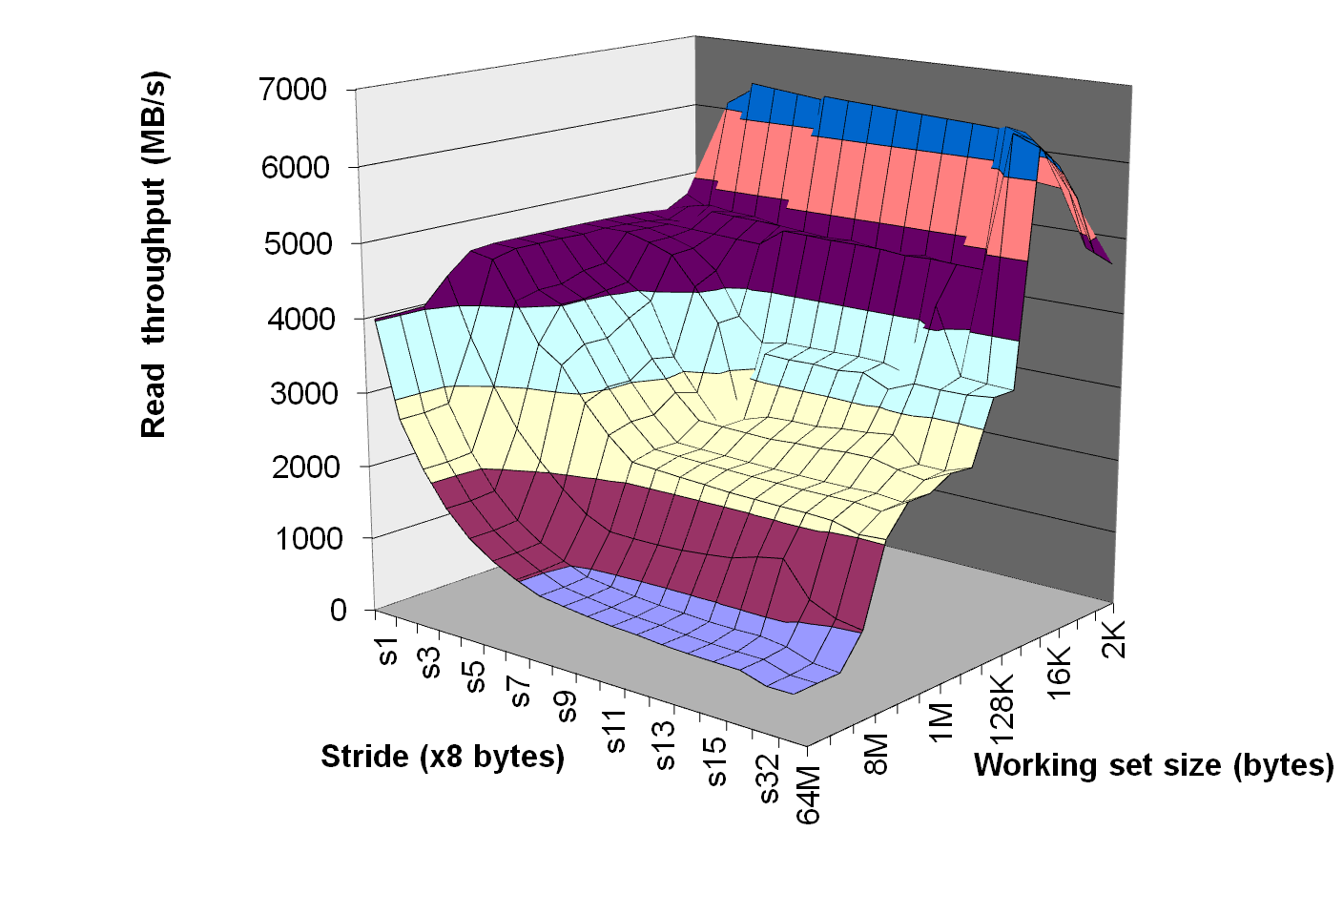
The Memory Mountain
Intel Core i7
32 KB L1 i-cache
32 KB L1 d-cache
256 KB unified L2 cache
8M unified L3 cache
All caches on-chip

Slide 25
The Memory Mountain
Intel Core i7
32 KB L1 i-cache
32 KB L1 d-cache
256 KB unified L2 cache
8M unified L3 cache
All caches on-chip
Slopes of
spatial
locality

Slide 26
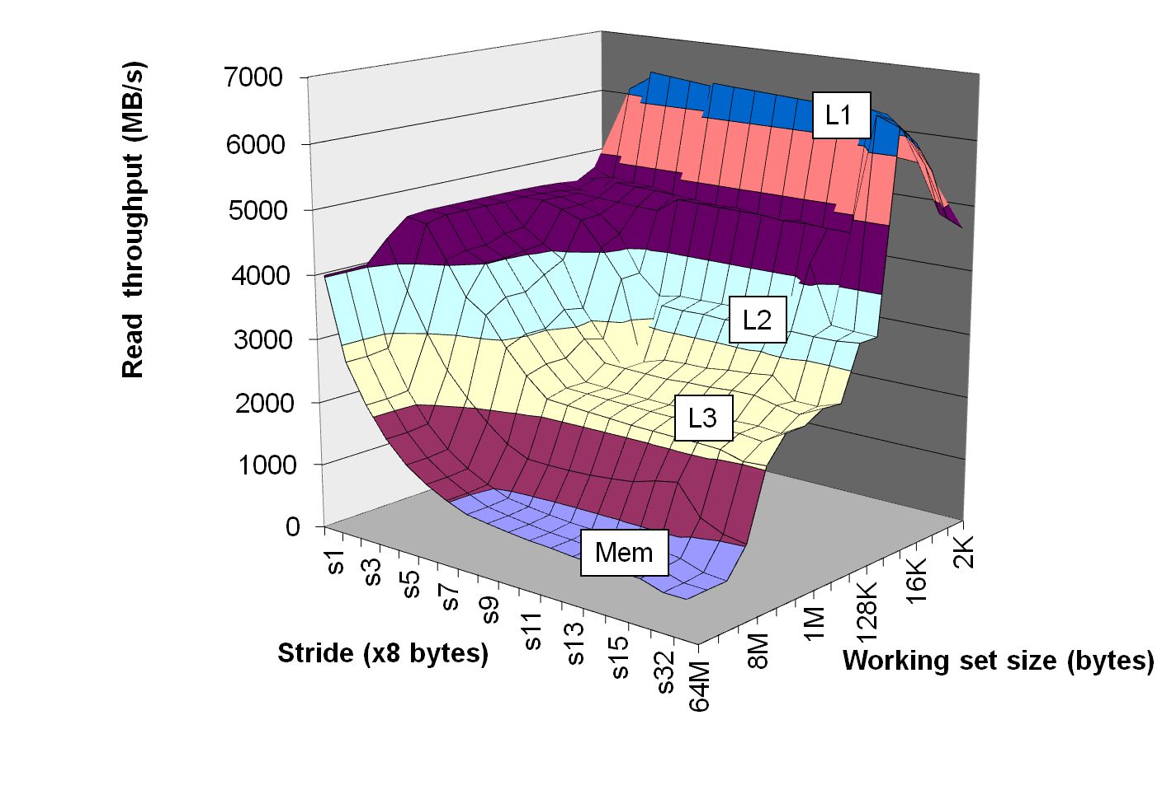
The Memory Mountain
Intel Core i7
32 KB L1 i-cache
32 KB L1 d-cache
256 KB unified L2 cache
8M unified L3 cache
All caches on-chip
Ridges of
Temporal
locality
Slopes of
spatial
locality

Slide 27
Today
Cache organization and operation
Performance impact of caches
  The memory mountain
  Rearranging loops to improve spatial locality
  Using blocking to improve temporal locality

Slide 28
Miss Rate Analysis for Matrix Multiply
Assume:
  Line size = 32B (big enough for four 64-bit words)
  Matrix dimension (N) is very large
    Approximate 1/N as 0.0
  Cache is not even big enough to hold multiple rows
Analysis Method:
  Look at access pattern of inner loop
k
j
j
i
k
i
A
B
C

Slide 29
Matrix Multiplication Example
Description:
  Multiply N x N matrices
  O(N³) total operations
  N reads per source element
  N values summed per destination
    but may be able to hold in register
Variable sum
held in register
/* ijk */
for (i=0; i<n; i++) {
for (j=0; j<n; j++) {
sum = 0.0;
for (k=0; k<n; k++)
sum += a[i][k] * b[k][j];
c[i][j] = sum;
}
}

Slide 30
Layout of C Arrays in Memory (review)
C arrays allocated in row-major order
  each row in contiguous memory locations
Stepping through columns in one row:
  for (i = 0; i < N; i++)
    sum += a[0][i];
  accesses successive elements
  if block size (B) > 4 bytes, exploit spatial locality
    compulsory miss rate = 4 bytes / B
Stepping through rows in one column:
  for (i = 0; i < N; i++)
    sum += a[i][0];
  accesses distant elements
  no spatial locality!
    compulsory miss rate = 1 (i.e. 100%)

Slide 31
Matrix Multiplication (ijk)
/* ijk */
for (i=0; i<n; i++) {
for (j=0; j<n; j++) {
sum = 0.0;
for (k=0; k<n; k++)
sum += a[i][k] * b[k][j];
c[i][j] = sum;
}
}
Inner loop:
(*,j)
(i,j)
(i,*)
A
B
C
Row-wise
Column-
wise
Fixed
Misses per inner loop iteration:
  A B C
  0.25 1.0 0.0

Slide 32
Matrix Multiplication (jik)
/* jik */
for (j=0; j<n; j++) {
for (i=0; i<n; i++) {
sum = 0.0;
for (k=0; k<n; k++)
sum += a[i][k] * b[k][j];
c[i][j] = sum
}
}
Inner loop:
(*,j)
(i,j)
(i,*)
A
B
C
Row-wise
Column-
wise
Fixed
Misses per inner loop iteration:
  A B C
  0.25 1.0 0.0

Slide 33
Matrix Multiplication (kij)
/* kij */
for (k=0; k<n; k++) {
for (i=0; i<n; i++) {
r = a[i][k];
for (j=0; j<n; j++)
c[i][j] += r * b[k][j];
}
}
Inner loop:
(i,k)
(k,*)
(i,*)
A
B
C
Fixed
Row-wise
Row-wise
Misses per inner loop iteration:
  A B C
  0.0 0.25 0.25

Slide 34
Matrix Multiplication (ikj)
/* ikj */
for (i=0; i<n; i++) {
for (k=0; k<n; k++) {
r = a[i][k];
for (j=0; j<n; j++)
c[i][j] += r * b[k][j];
}
}
Inner loop:
(i,k)
(k,*)
(i,*)
A
B
C
Fixed
Row-wise
Row-wise
Misses per inner loop iteration:
  A B C
  0.0 0.25 0.25

Slide 35
Matrix Multiplication (jki)
Inner loop:
/* jki */
for (j=0; j<n; j++) {
for (k=0; k<n; k++) {
r = b[k][j];
for (i=0; i<n; i++)
c[i][j] += a[i][k] * r;
}
}
(*,k)
(*,j)
(k,j)
A
B
C
Column-
wise
Fixed
Column-
wise
Misses per inner loop iteration:
  A B C
  1.0 0.0 1.0

Slide 36
Matrix Multiplication (kji)
/* kji */
for (k=0; k<n; k++) {
for (j=0; j<n; j++) {
r = b[k][j];
for (i=0; i<n; i++)
c[i][j] += a[i][k] * r;
}
}
Inner loop:
(*,k)
(*,j)
(k,j)
A
B
C
Column-
wise
Fixed
Column-
wise
Misses per inner loop iteration:
  A B C
  1.0 0.0 1.0

Slide 37
Summary of Matrix Multiplication
for (i=0; i<n; i++) {
for (j=0; j<n; j++) {
sum = 0.0;
for (k=0; k<n; k++)
sum += a[i][k] * b[k][j];
c[i][j] = sum;
}
}
ijk (& jik):
  2 loads, 0 stores
  misses/iter = 1.25
for (k=0; k<n; k++) {
for (i=0; i<n; i++) {
r = a[i][k];
for (j=0; j<n; j++)
c[i][j] += r * b[k][j];
}
}
kij (& ikj):
  2 loads, 1 store
  misses/iter = 0.5
for (j=0; j<n; j++) {
for (k=0; k<n; k++) {
r = b[k][j];
for (i=0; i<n; i++)
c[i][j] += a[i][k] * r;
}
}
jki (& kji):
  2 loads, 1 store
  misses/iter = 2.0

Slide 38
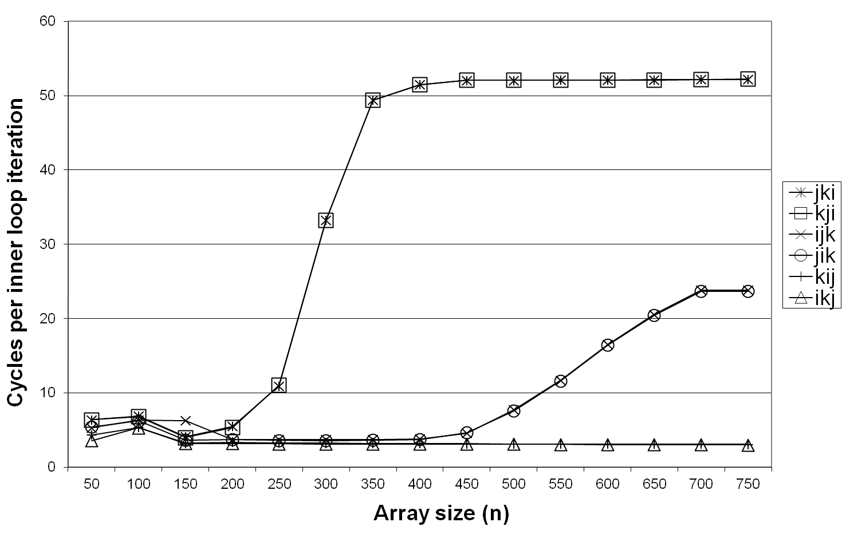
Core i7 Matrix Multiply Performance
jki / kji
ijk / jik
kij / ikj

Slide 39
Today
Cache organization and operation
Performance impact of caches
  The memory mountain
  Rearranging loops to improve spatial locality
  Using blocking to improve temporal locality

Slide 40
Example: Matrix Multiplication
c = (double *) calloc(sizeof(double), n*n);
/* Multiply n x n matrices a and b */
void mmm(double *a, double *b, double *c, int n) {
int i, j, k;
for (i = 0; i < n; i++)
for (j = 0; j < n; j++)
for (k = 0; k < n; k++)
c[i*n+j] += a[i*n + k]*b[k*n + j];
}
j
c
a
b
=
*
i

Slide 41
Cache Miss Analysis
Assume:
  Matrix elements are doubles
  Cache block = 8 doubles
  Cache size C << n (much smaller than n)
First iteration:
  n/8 + n = 9n/8 misses
  Afterwards in cache:
  (schematic)
n
=
*
=
*
8 wide

Slide 42
Cache Miss Analysis
Assume:
  Matrix elements are doubles
  Cache block = 8 doubles
  Cache size C << n (much smaller than n)
Second iteration:
  Again:
  n/8 + n = 9n/8 misses
Total misses:
  9n/8 * n² = (9/8) * n³
n
=
*
8 wide

Slide 43
Blocked Matrix Multiplication
c = (double *) calloc(sizeof(double), n*n);
/* Multiply n x n matrices a and b */
void mmm(double *a, double *b, double *c, int n) {
int i, j, k;
for (i = 0; i < n; i+=B)
for (j = 0; j < n; j+=B)
for (k = 0; k < n; k+=B)
/* B x B mini matrix multiplications */
for (i1 = i; i1 < i+B; i++)
for (j1 = j; j1 < j+B; j++)
for (k1 = k; k1 < k+B; k++)
c[i1*n+j1] += a[i1*n + k1]*b[k1*n + j1];
}
j1
c
a
b
c
=
*
+
i1
Block size B x B

Slide 44
Cache Miss Analysis
Assume:
  Cache block = 8 doubles
  Cache size C << n (much smaller than n)
  Three blocks fit into cache: 3B² < C
First (block) iteration:
  B²/8 misses for each block
  2n/B * B²/8 = nB/4
  (omitting matrix c)
  Afterwards in cache
  (schematic)
n/B blocks
=
*
Block size B x B
=
*

Slide 45
Cache Miss Analysis
Assume:
  Cache block = 8 doubles
  Cache size C << n (much smaller than n)
  Three blocks fit into cache: 3B² < C
Second (block) iteration:
  Same as first iteration
  2n/B * B²/8 = nB/4
Total misses:
  nB/4 * (n/B)² = n³/(4B)
n/B blocks
=
*
Block size B x B

Slide 46
Summary
No blocking: (9/8) * n³
Blocking: 1/(4B) * n³
Suggest largest possible block size B, but limit 3B² < C!
Reason for dramatic difference:
  Matrix multiplication has inherent temporal locality:
    Input data: 3n², computation 2n³
    Every array elements used O(n) times!
  But program has to be written properly

Slide 47
Concluding Observations
Programmer can optimize for cache performance
  How data structures are organized
  How data are accessed
    Nested loop structure
    Blocking is a general technique
All systems favor “cache friendly code”
  Getting absolute optimum performance is very platform specific
    Cache sizes, line sizes, associativities, etc.
  Can get most of the advantage with generic code
    Keep working set reasonably small (temporal locality)
    Use small strides (spatial locality)

